Slide 1
Decision Trees

Slide 2
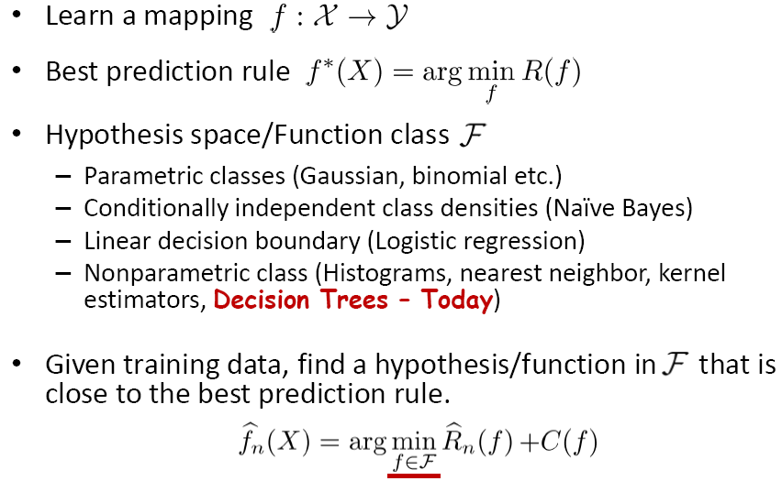
Learning a good prediction rule

Slide 3
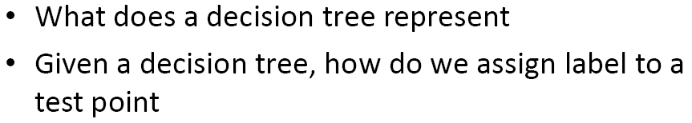
First …

Slide 4
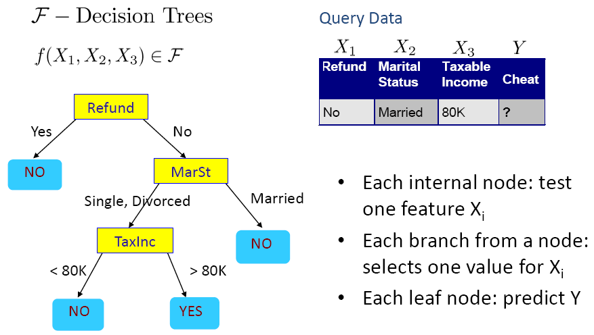
Decision Tree for Tax Fraud Detection

Slide 5
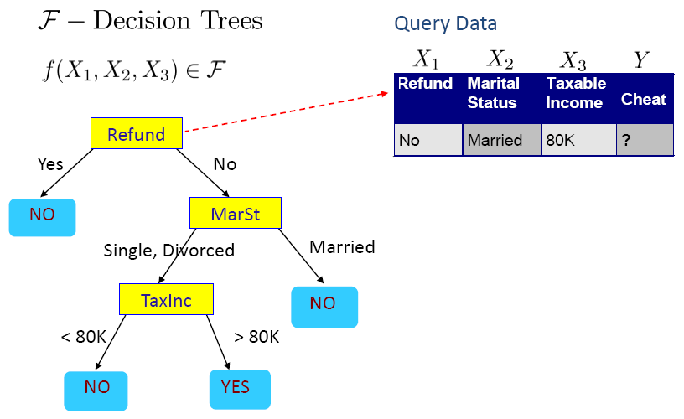
Decision Tree for Tax Fraud Detection

Slide 6
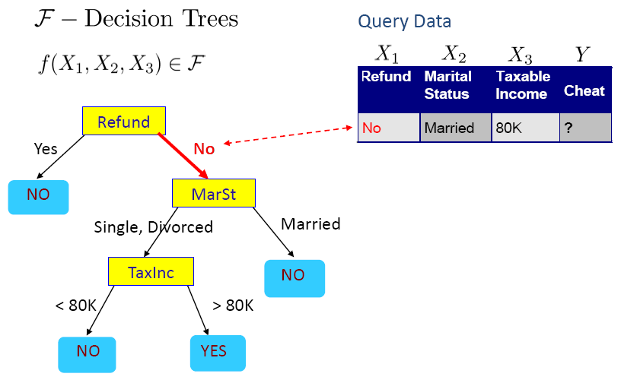
Decision Tree for Tax Fraud Detection

Slide 7

Decision Tree for Tax Fraud Detection

Slide 8

Decision Tree for Tax Fraud Detection

Slide 9
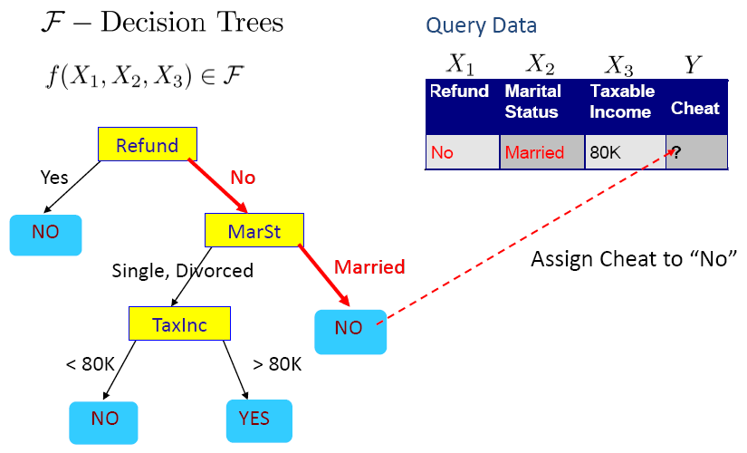
Decision Tree for Tax Fraud Detection

Slide 10
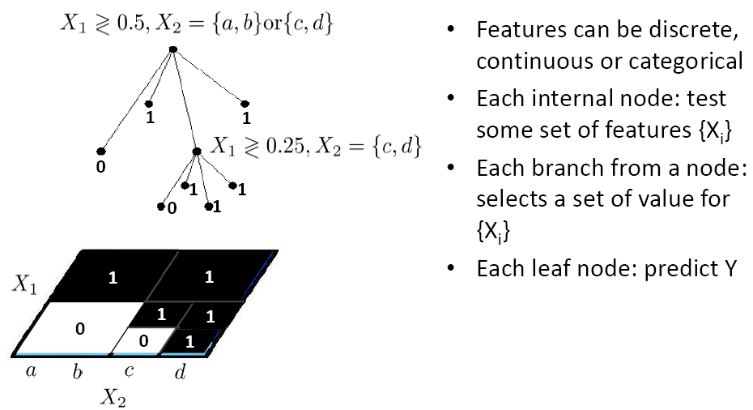
Decision tree more generally

Slide 11
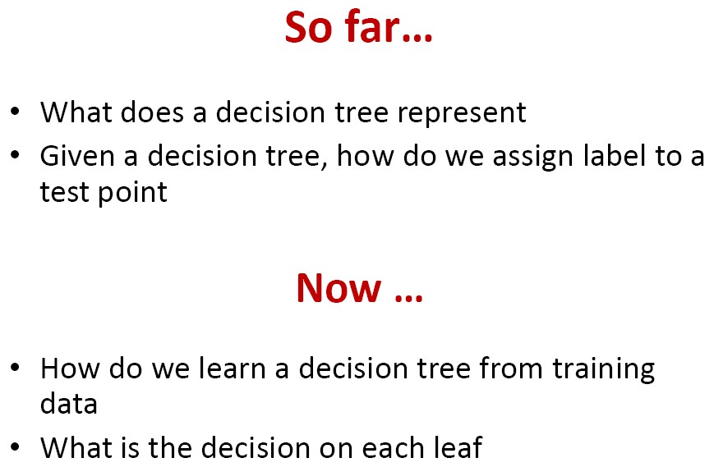

Slide 12
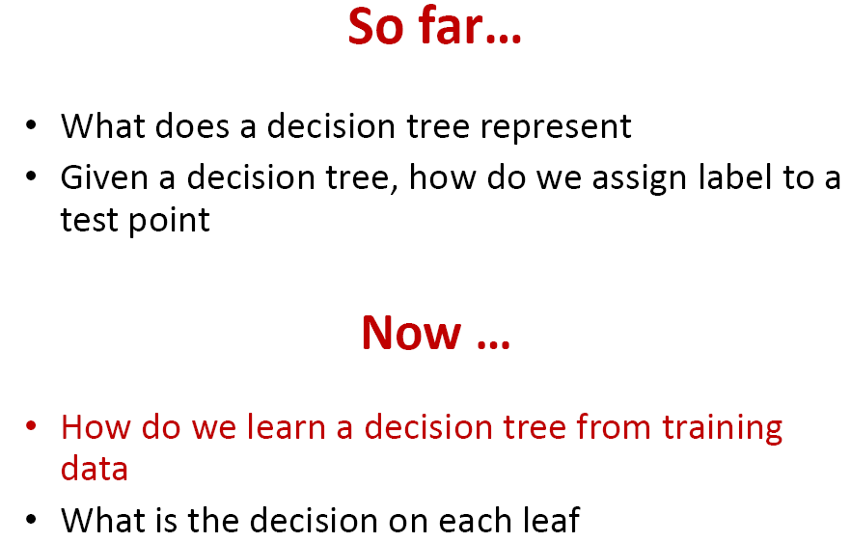

Slide 13
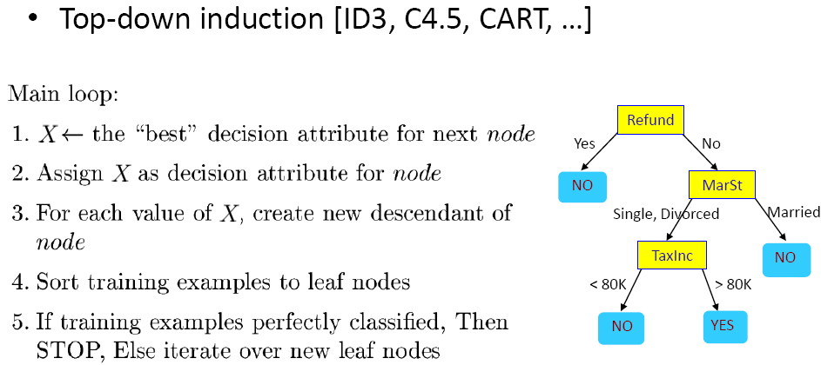
How to learn a decision tree?

Slide 14
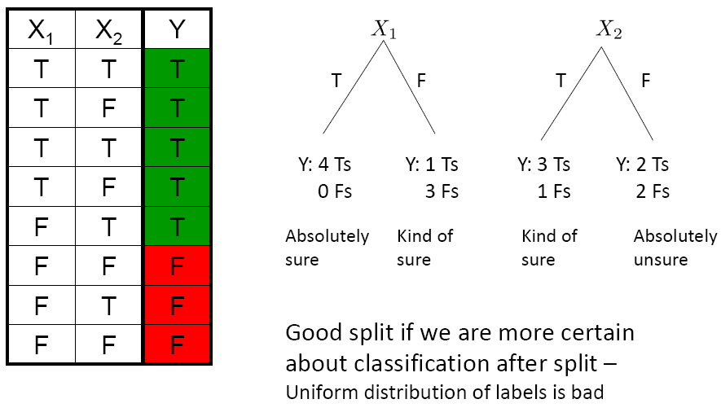
Which feature is best to split?

Slide 15
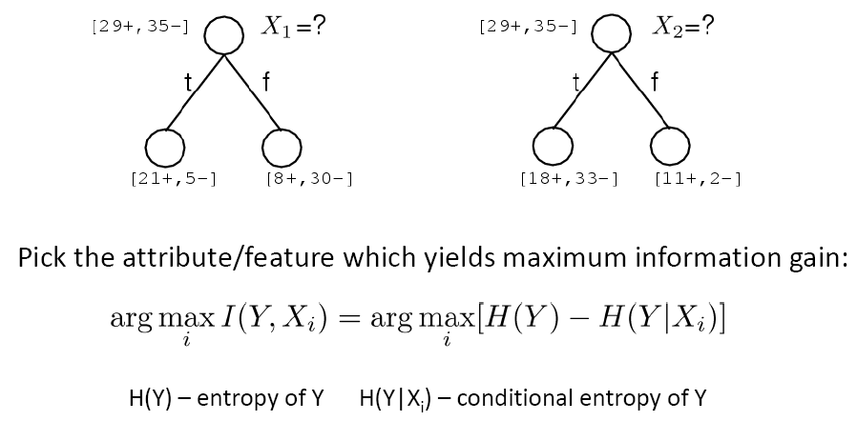
Which feature is best to split?

Slide 16
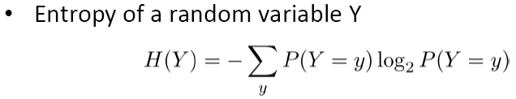
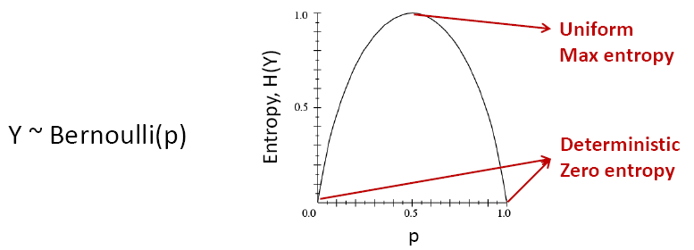

Entropy

Slide 17
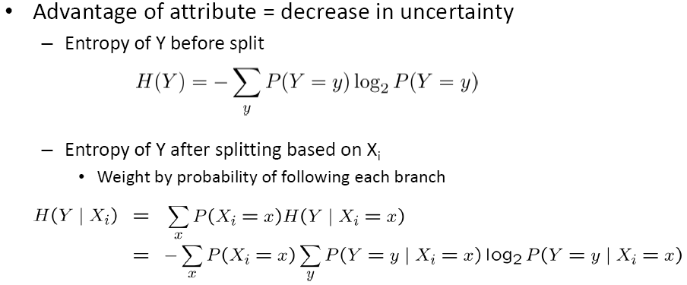

Information Gain

Slide 18
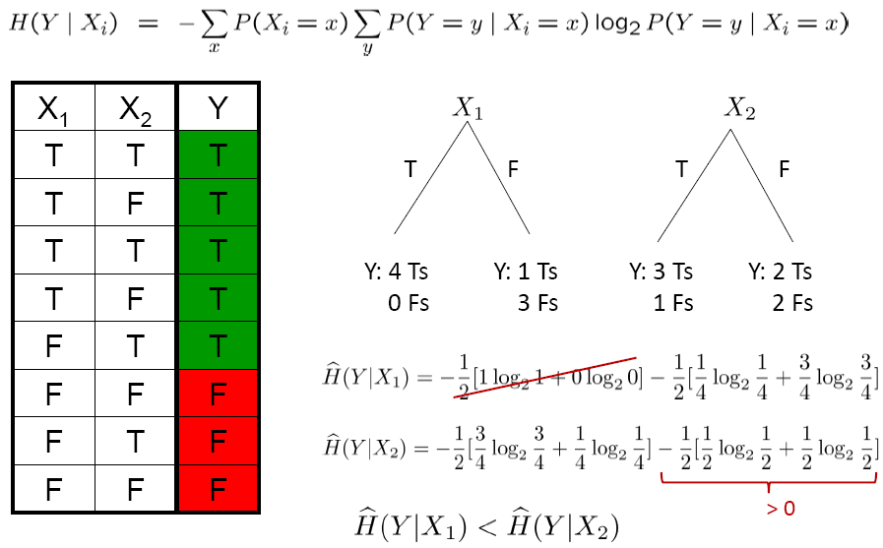
Information Gain

Slide 19


Gain ratio (C4.5)
Information gain has a preference for attributes with more values.
  Consider numbering as an attribute.
  The more possible values of the attribute Xi (that is, greater V), the greater the value of IV(Xi) is usually

Slide 20
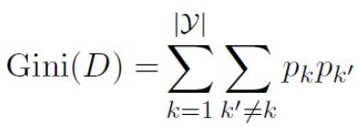
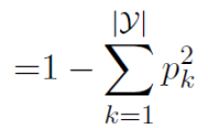
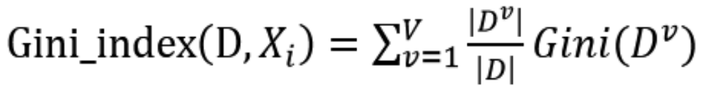
Gini index (CART)
It reflects the probability that two samples are randomly selected from D, whose category markers are inconsistent.
The smaller the Gini(D), the higher the purity of the dataset D

Slide 21
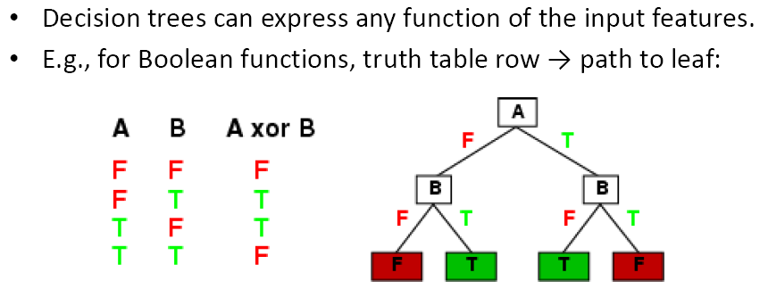
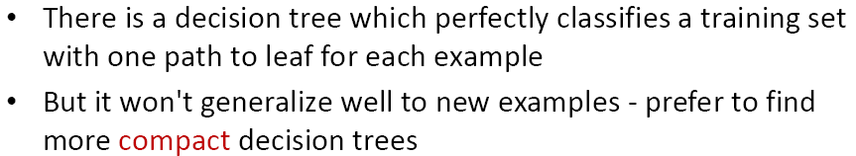
Expressiveness of Decision Trees

Slide 22
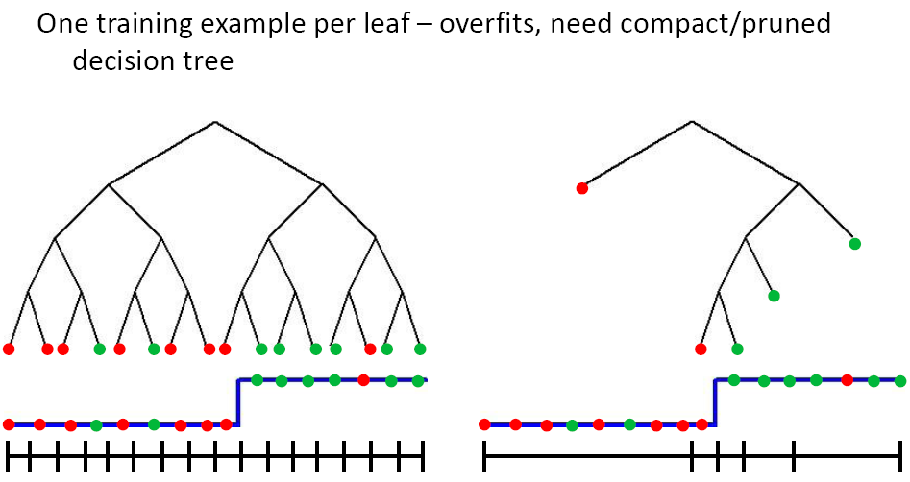
Decision Trees - Overfitting

Slide 23
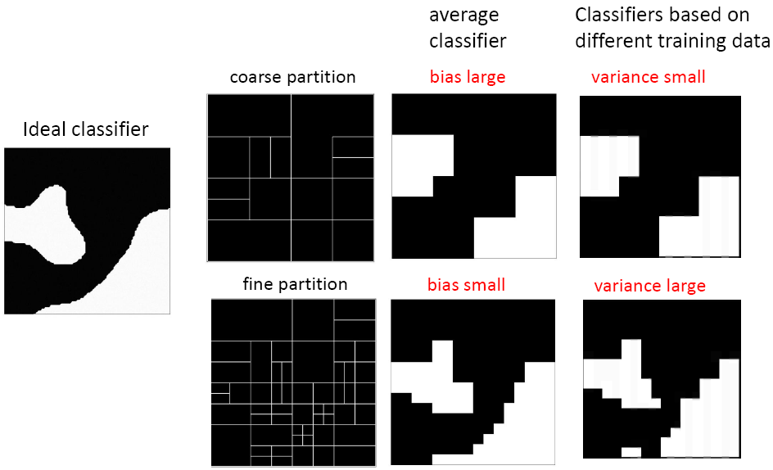
Bias-Variance Tradeoff

Slide 24
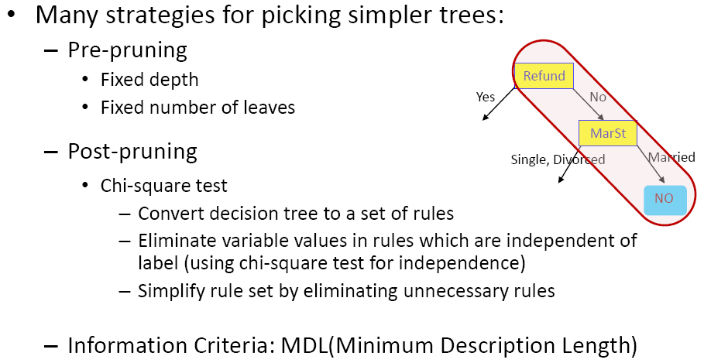
When to stop?

Slide 25
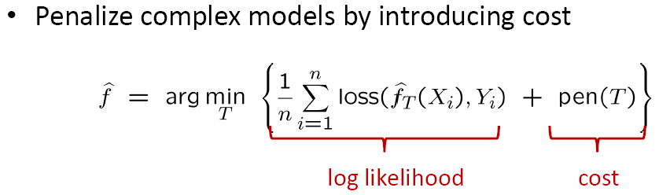
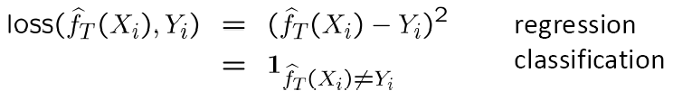
Information Criteria

Slide 26
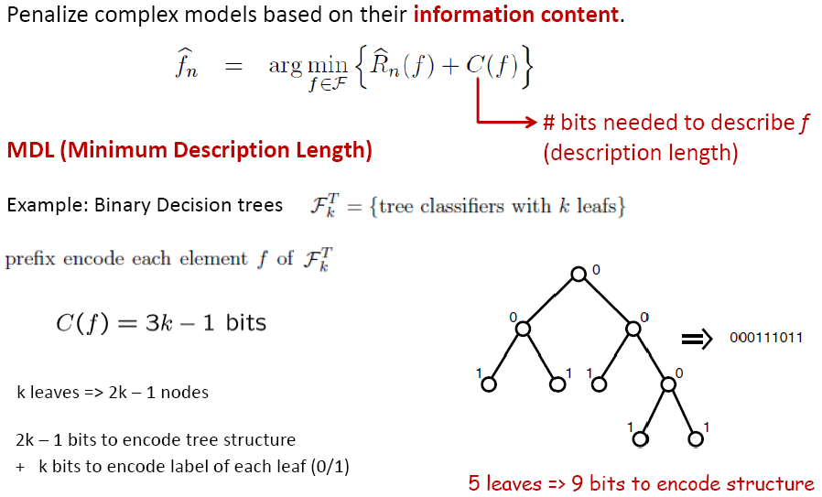
Information Criteria - MDL

Slide 27
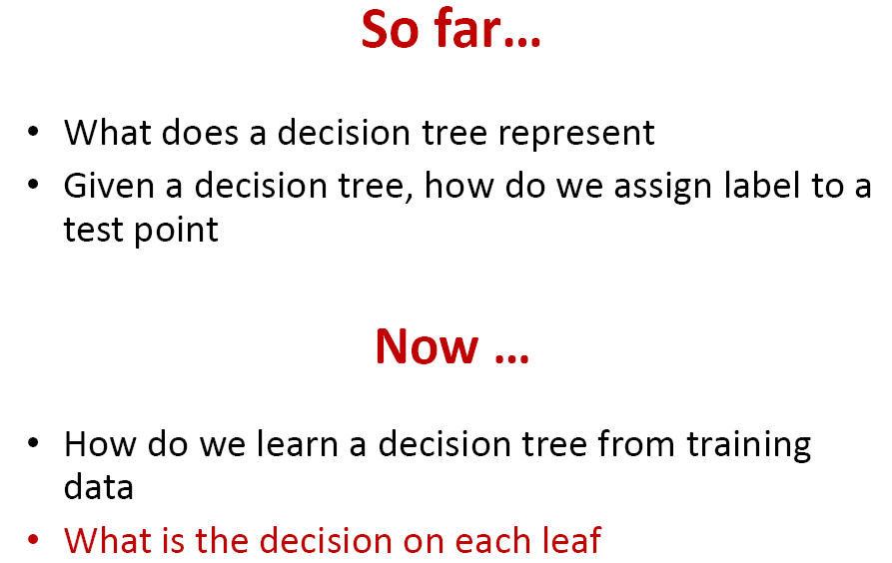

Slide 28
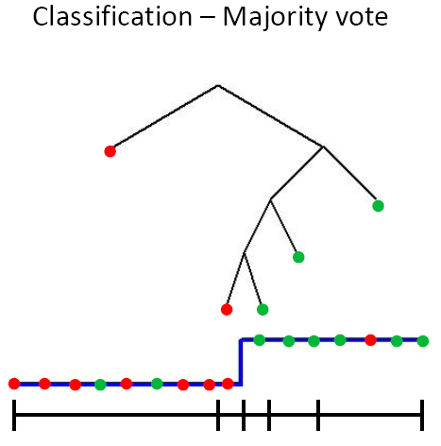
How to assign label to each leaf

Slide 29
Connection between
nearest neighbor/histogram classifiers
and
decision trees

Slide 30

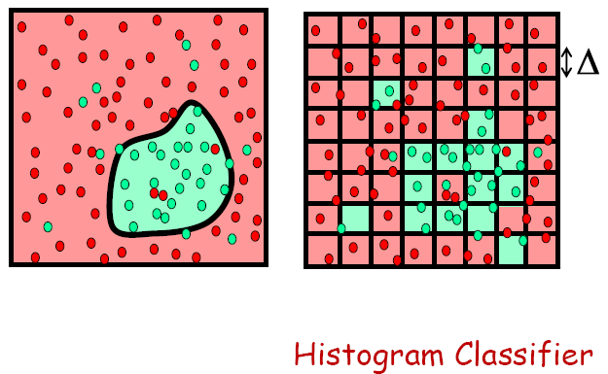
Local prediction

Slide 31
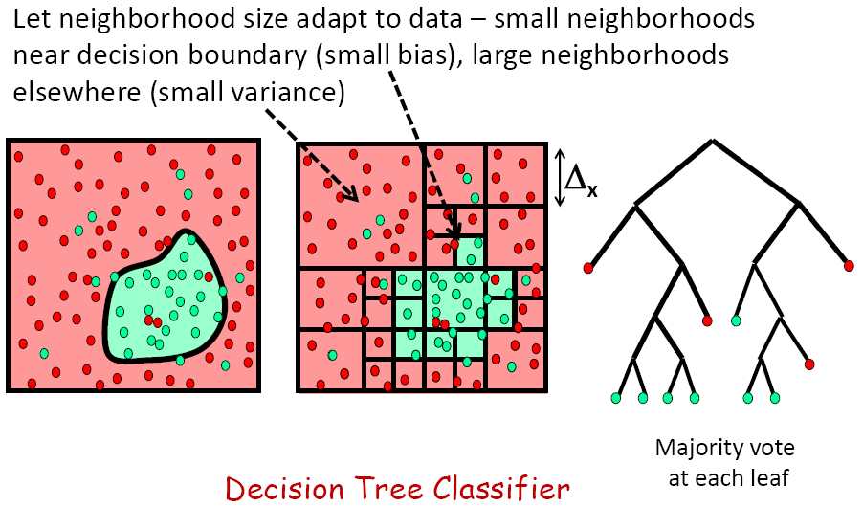
Local adaptive prediction

Slide 32
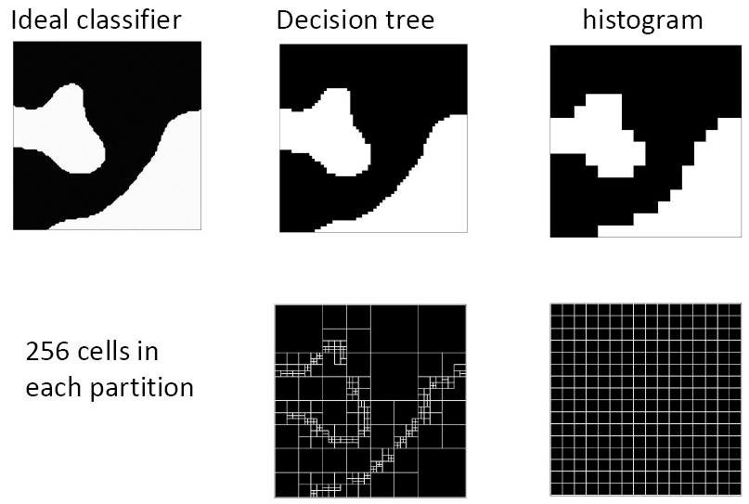
Histogram Classifier vs. Decision Trees

Slide 33
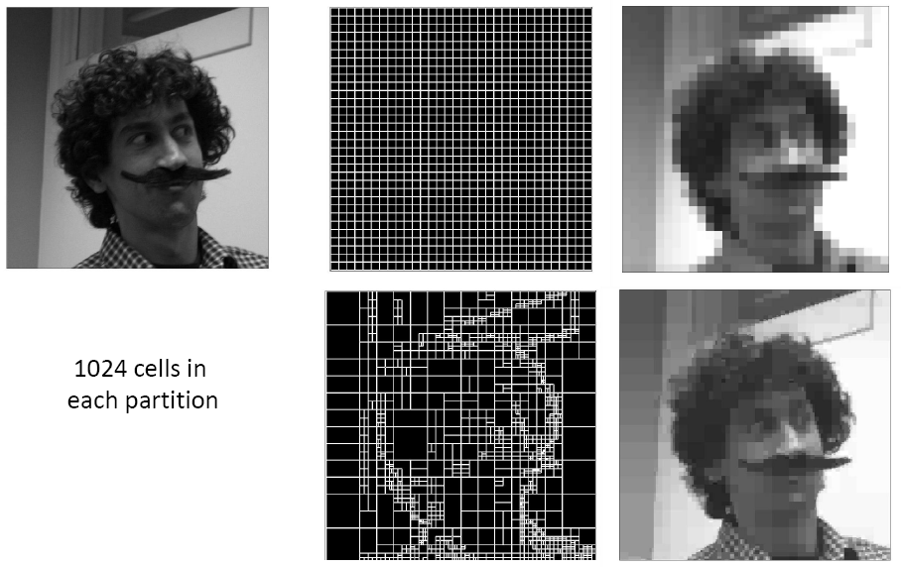
Application to Image Coding

Slide 34
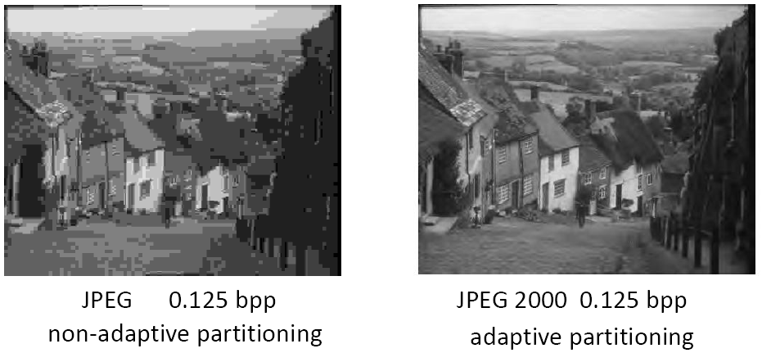
Application to Image Coding

Slide 35
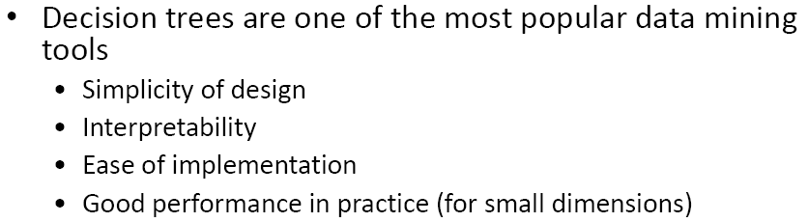
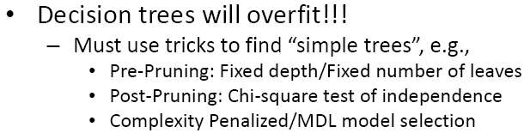
What you should know

